Slide 1
STUDENT ATTENDANCE MONITORING USING FACIAL RECOGNITION IN A CLASSROOM
Team members
K CHANDRASEKARAN RA1711004040028
S AATHITH RA1711004040030

Slide 2
Existing problem
Student’s attendance in the classroom is a very important task
The existing method of taking attendance consumes a finite of amount of time which can be used for other productive action.
We are focused on addressing this problem on schools and universities only.

Slide 3
Motivation
We found this problem in many universities
We want a reliable system which identifies which student is present in the classroom and gives the attendance based on his presence
This system must not be complex and very easy to interact with it

Slide 4
Existing Recognition systems
The systems can be broadly classified :
Systems that uses human characteristics like fingerprint
Systems that uses unique objects that the person carries like ID card

Slide 5
Fingerprint based recognition system
Distracts the attention of students during lecture time
Queuing takes place

Slide 6
RFID based recognition
Possibilities that Fraudulent may occur
Cheat the system by giving proxy (for example a student misuse it by wearing another student’s ID card )

Slide 7
IRIS based recognition system
Cant use a regular camera
Visible light must be minimized for maximum accuracy

Slide 8
Proposed work
Attendance is monitored and marked present or absent depending upon the presence of the student inside the class at the particular time of lecture
Our solution uses a camera that takes photo of a group of students, and then uses facial recognition for marking attendance for a student
We found that facial recognition overcomes some of the problems that exist in the previously mentioned attendance systems
Our solution makes sure that there is a minimal interaction between students and the attendance monitoring system

Slide 9
Facial recognition
Any facial recognition has 2 steps
Facial detection – the process of finding a face in a given image
Facial recognition – the process of identifying the person from the image of a face (example : face id in apple )
The process of facial recognition occurs in a separate computer as the burden on the camera system must be reduced

Slide 10
Hardware
Camera is installed on the classroom
The role of the camera is just to take pictures
But the process of facial recognition takes place in another computer

Slide 11
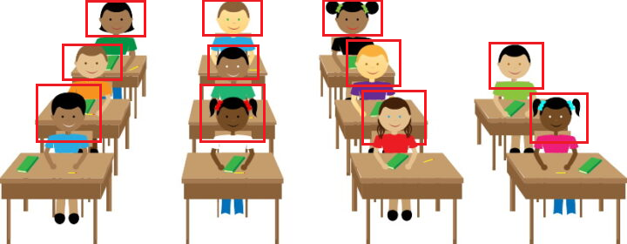
Facial recognition in class – an idea

Slide 12
Sub Systems

Slide 13
Major Sub systems
System Attached in the class to take photos (Image processing)
System that marks the attendance against the face in the photos(ML/DL)

Slide 14
System that takes photo
Camera
System that signals the camera
System that transports the photo to next system for processing the photos

Slide 15
System that marks the attendance
System that receives the photo
System that runs the face detection algorithm that outputs “m” detected faces
System that outputs a descriptor for “m” faces
System that iterates through “m” descriptor and marks the attendance

Slide 16
System that outputs a descriptor for “m” faces
System that iterates through the “m” detected faces and calls the following sub systems
System that outputs a descriptor(fixed size) for one face (Facial recognition)
System that stores these “m” descriptors

Slide 17
System that iterates through “m” descriptor and marks the attendance
System that iterates through the database containing “n” descriptors
System that checks whether 2 descriptors are same
System that gives the register number of a given descriptor
System that marks the attendance against the register number

Slide 18
Mathematical Modelling

Slide 19
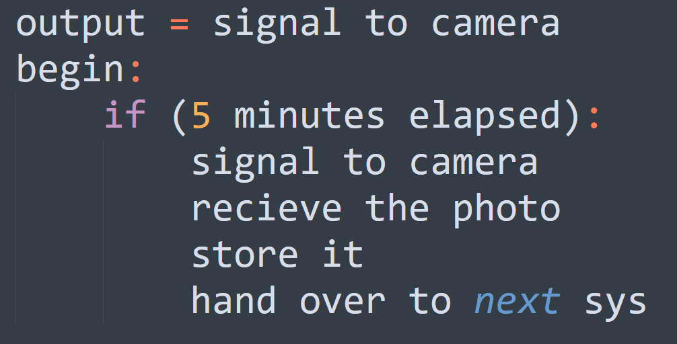
System that signals the camera

Slide 20
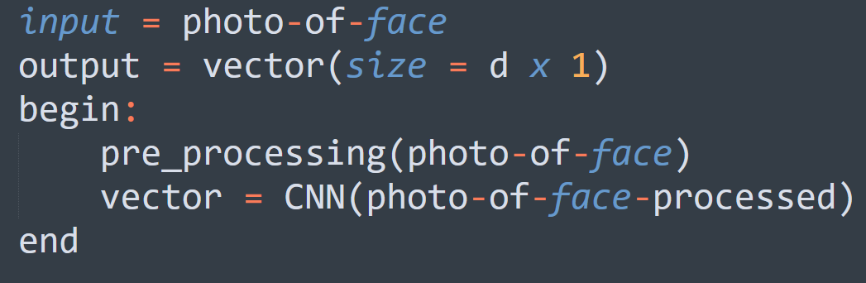
System that outputs a descriptor(fixed size) for one face (Facial recognition)

Slide 21
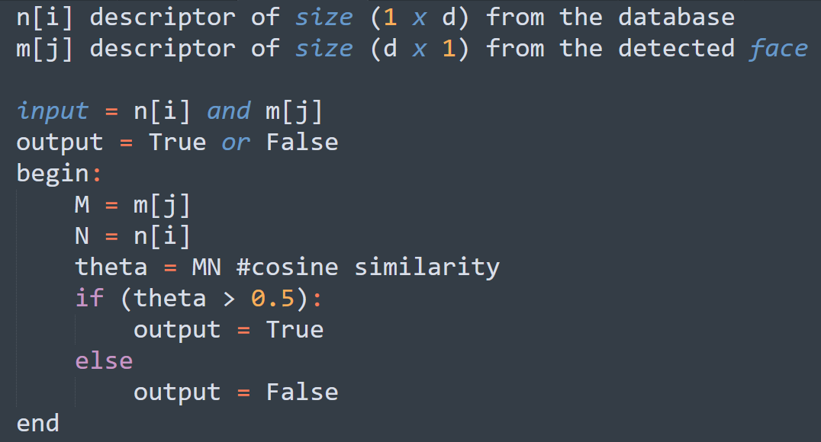
System that checks whether 2 descriptors are same

Slide 22
Thank You

